Slide 1
Model Training & Evaluation Guideline
MindSpore Challenge - Pathology Diagnosis

Slide 2




Competition Timeline
15 OCT 2021
Model
Submission
Deadline
AI Image Pathology
Diagnosis Training
Final Pitching
Present to the Judges for the final round evaluation and scoring
Please refer to rule books for criteria
Further knowledge on Explainable AI & Pathology Diagnosis
20 SEP 2021
22 OCT 2021
1
2
3
4
3
4
5
16 SEP 2021
28 SEP 2021
26 OCT 2021
MindSpore Fundamental
Training
Briefing Session
Award Ceremony
Q&A Session for all participants
Winning Teams will be invited to the Annual Huawei Cloud Summit for the Awarding Ceremony
Teaching participants how to use MindSpore, ModelArts and evaluation platform
Registration
Deadline
24 SEP 2021

Slide 3
Huawei Cloud Basic
The basic guideline of how to use the Huawei Cloud

Slide 4



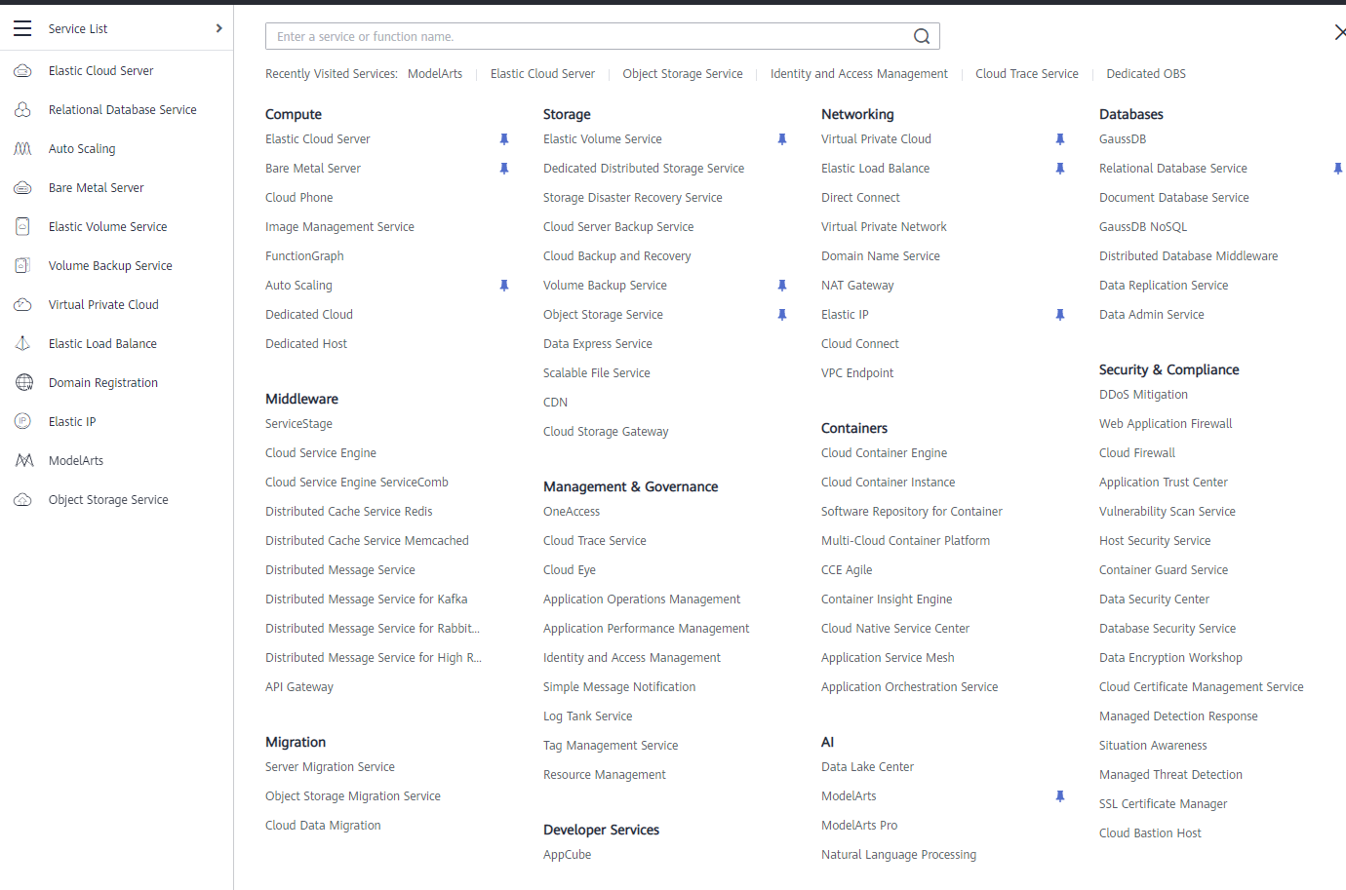
What is Huawei Cloud
Elastic Cloud Service
OBS
A powerful compute engine for you to deploy any application
A cloud storage service optimized for storing massive amounts of data
A leading cloud service provider, with storage, AI Platform, and many other services.
And More!!!
ModelArts
A one-stop development platform for AI developers

Slide 5
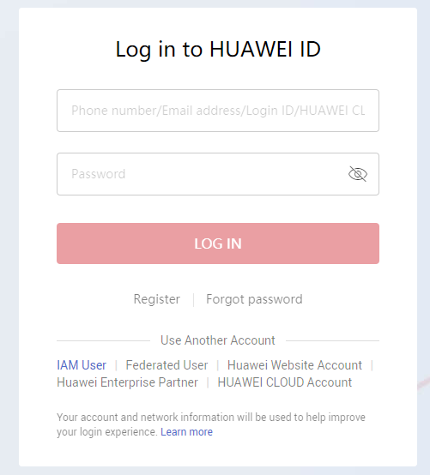
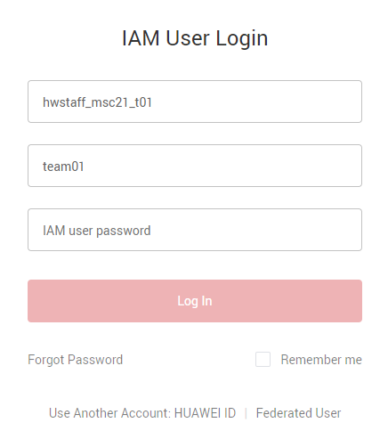
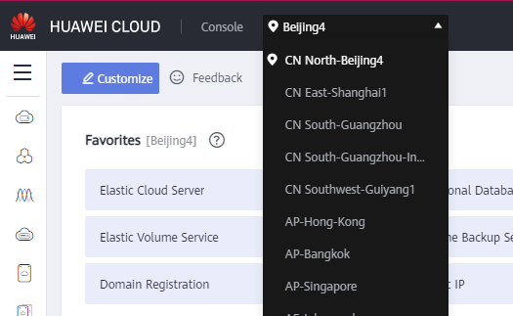
Login with IAM
Identity and Access Management (IAM) enables you to easily manage users and control their access to HUAWEI CLOUD services and resources.
Press IAM User in Login Page
Fill in with the related info
Change the Location to CN North-Beijing4

Slide 6
Model Training Stage
Detail about the training procedure on ModelArts

Slide 7
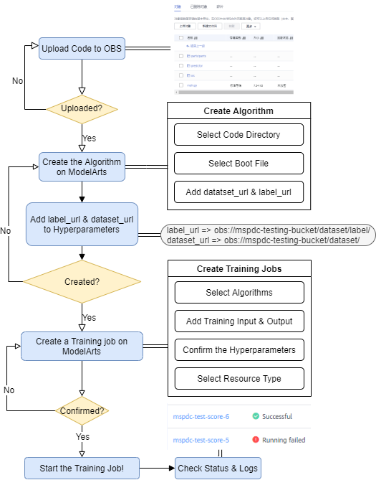
Training Flow Overview
Huawei Cloud | It’s a cloud service provider with the features of data storage and AI Platform
ModelArts | A one-stop development platform for AI developers from data to output
OBS | Cloud storage service optimized for storing massive amounts of data
Main Procedures
1
Upload code to OBS
2
Create Algorithm on Huawei Cloud ModelArts
3
Create Training Jobs on Huawei Cloud ModelArts
4
Start training & Post-Training

Slide 8
Upload Code to OBS
/01
What & Why OBS?
How to create a bucket and upload files?
How to manage the file structure

Slide 9
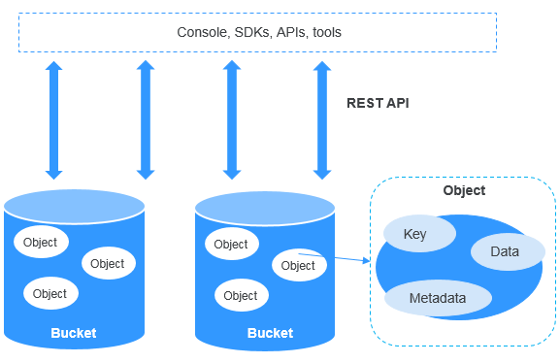
What & Why OBS?
01
Cloud Storage
Object Storage Service (OBS) is a cloud storage service optimized for storing massive amounts of data.
It can store your Code/ Dataset/ Training Output and so on.
OBS Official Document
Best OBS Practices
Train a model with OBS
02
Bucket and Object
Bucket = container for storing objects in OBS, which has specific storage class.
Object = basic unit of data storage in OBS, which consists of a key, metadata, and data.
03
Why to use it?
Upload your training code here for the connection to ModelArts!
Store output of your checkpoint, weight from the trained models!
Easily manage all your resources on cloud!

Slide 10
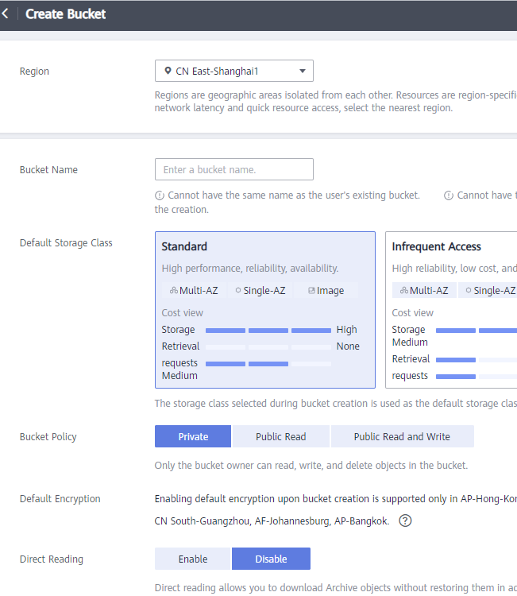
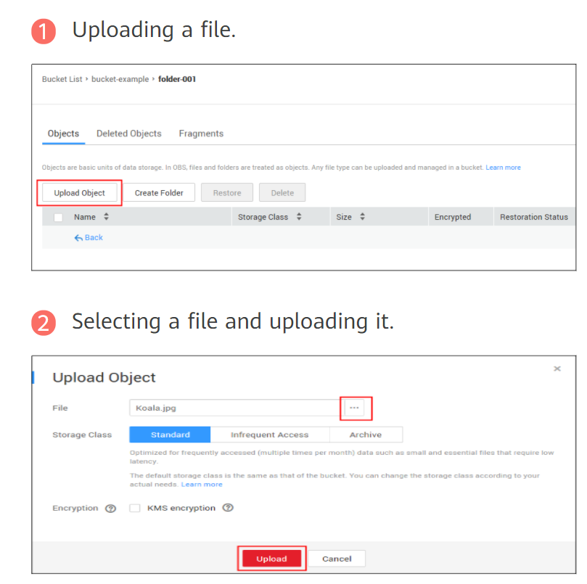
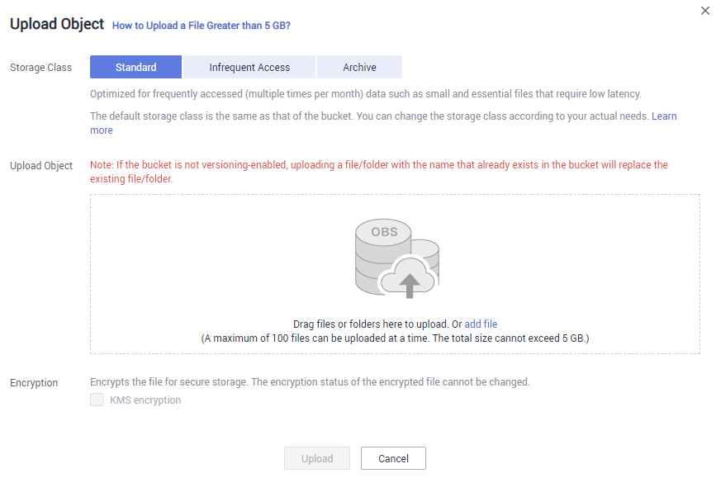
Create Bucket and Upload Files
Create a Bucket
OBS Console > Object Storage > Create Bucket (upper right)
Upload to Bucket
Object Storage > Overview > Objects > Upload Object

Slide 11
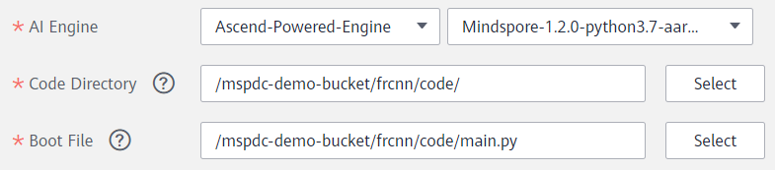
How to Manage the File Structure
Since Model Arts Algorithm creation need to know your source code position…
Using different main folder to separate different algorithms
There should be one entry point to handle parameters
mspdc-demo-bucket
frcnn
Code
out
yolov3
BUCKET
Root Folder
Code & Output
Main.py
Entry point
Model Arts Algorithm

Slide 12
Create Algorithm on ModelArts
/02
What is ModelArts
How to create an Algorithm

Slide 13
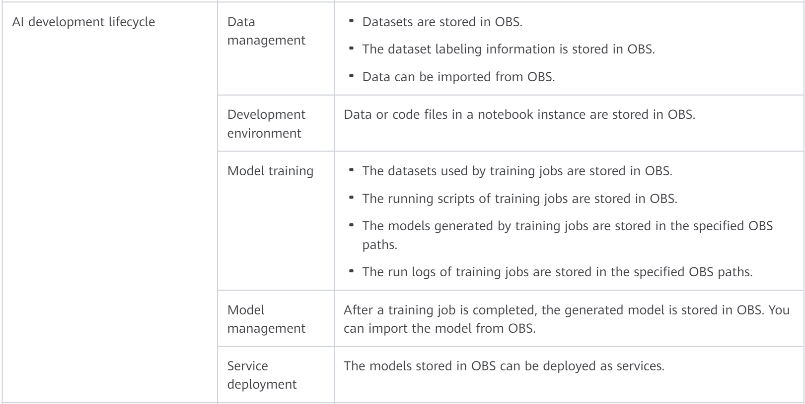
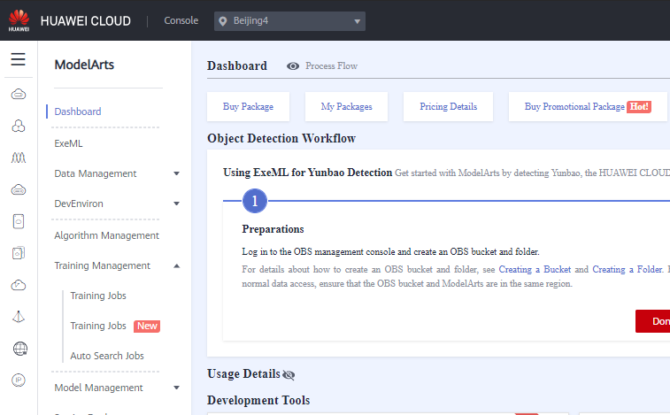
What is ModelArts?
ModelArts is a one-stop development platform for AI developers
MoXing deep learning framework accelerates training
Optimized GPU & Ascend AI chips achieve more efficient inference
What will we do on ModelArts?
Create an Algorithm
Upload locally developed algorithms or algorithms developed using other tools to ModelArts for unified management
Create a Training Job Using an Algorithm
Quickly create a training job on ModelArts to obtain the desired model using the algorithm you have created
Introduction to AI Lifecycle
ModelArts Official Document
ModelArts Algorithm Management
ModelArts Model Training Management
Moxing Framework Guideline

Slide 14

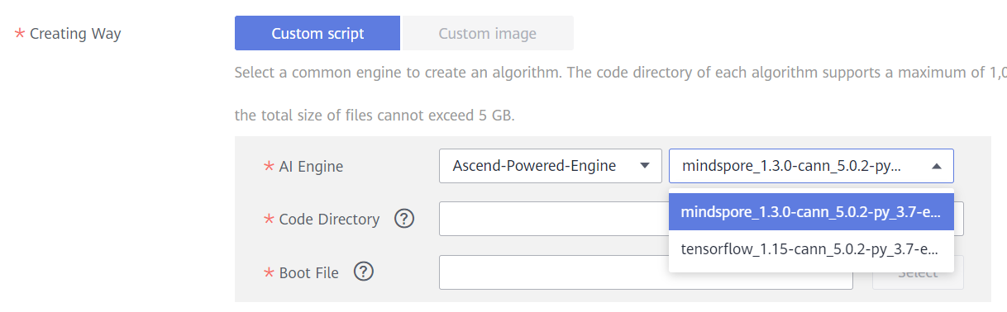
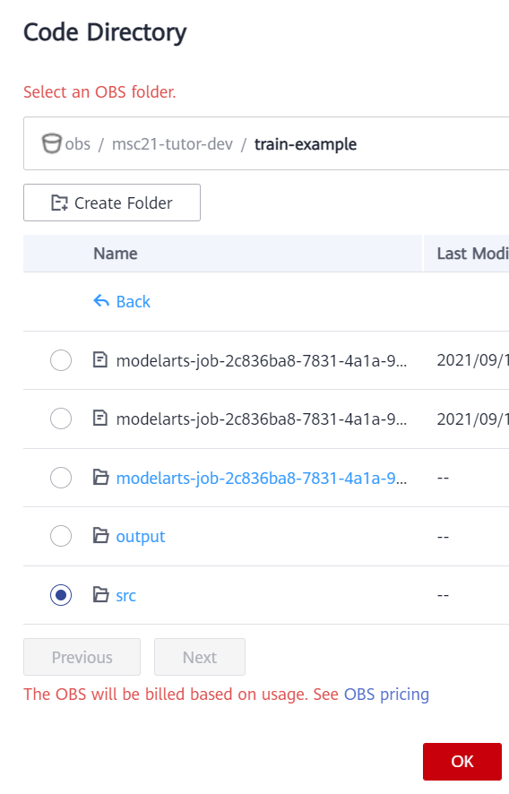
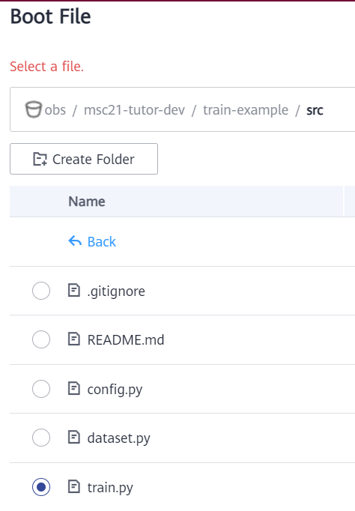
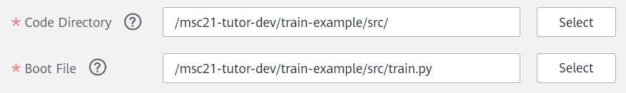
Create an Algorithm
Algorithm Management > My Algorithms > Create
01. Basic Information
Name
Description
02.Creating Way (Custom Script)
AI Engine
Code Directory + Boot File
03. Hyperparameters
dataset_url => to training images dataset
label_url => to training images’ label
metadata_url => images metadata
04. In/Out Path Configuration
Input path mapping
Output path mapping (make sure the folder exists)

Slide 15
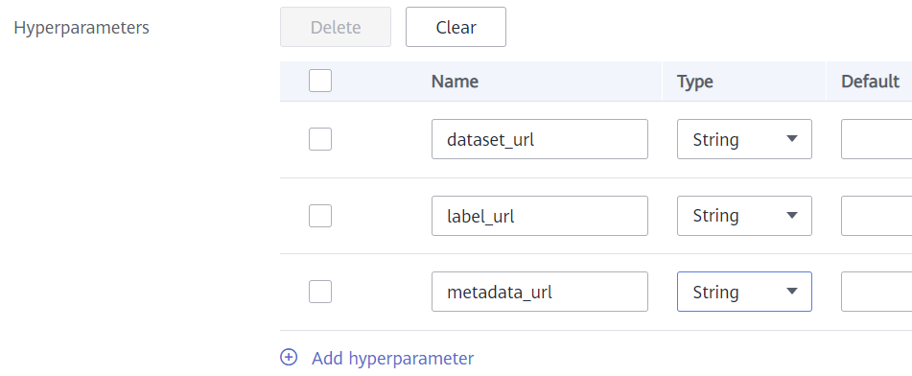
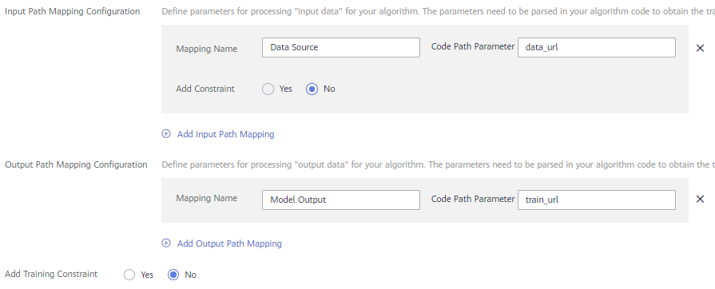
How to Create an Algorithm?
dataset_url => string
label_url => string
metadata_url => string
Algorithm Management > My Algorithms > Create
01. Basic Information
Name
Description
02.Creating Way (Custom Script)
AI Engine
Code Directory + Boot File
03. Hyperparameters
dataset_url => to training images dataset
label_url => to training images’ label
metadata_url => images metadata
04. In/Out Path Configuration
Input path mapping
Output path mapping (make sure the folder exists)

Slide 16
Create training jobs on ModelArts
/03
How to create a Training Job
Connect ModelArts & OBS - Moxing

Slide 17
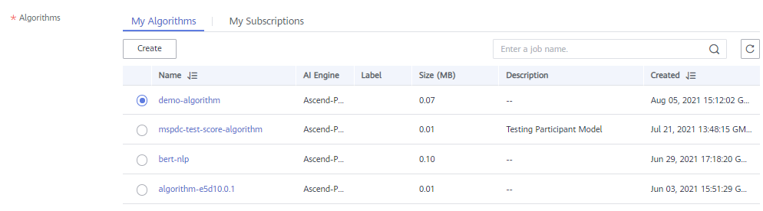
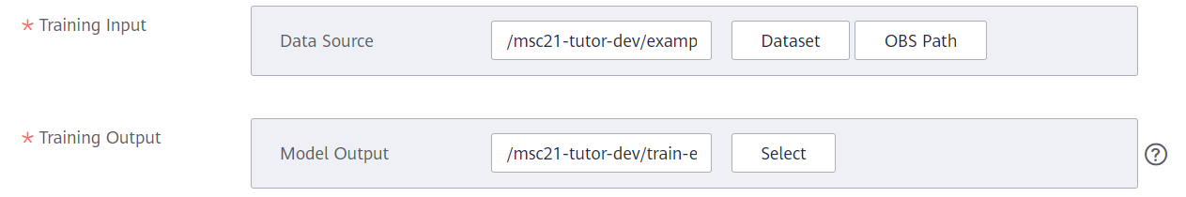
How to Create a Training Job?
Algorithm Management > My Algorithms > Create Training Job (Operation Column)
01. Algorithms
My Algorithms → choose the algorithm just created
02. Training Input/Output
Data Source = data_url (should be replaced by dataset_url)
Model Output = train_url
03. Hyperparameter
dataset_url => to training images dataset
label_url => to training images’ label
04. Resource Configuration
Data Source = data_url => any thing you like (will be replaced)
Model Output = train_url => obs://msc21-tutor-dev/train-example/output/
Resource Pool & Type
Instance & Compute Nodes
Job Log Path

Slide 18
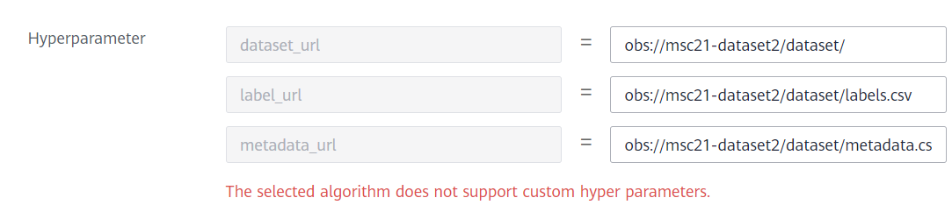
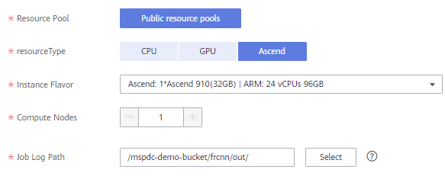
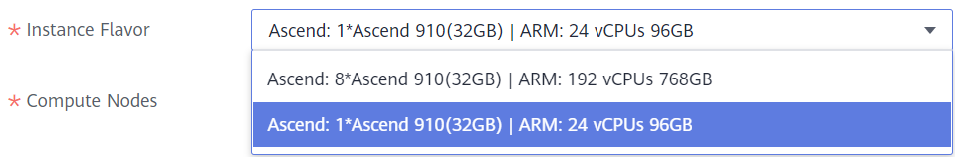
How to Create a Training Job?
Algorithm Management > My Algorithms > Create Training Job (Operation Column)
dataset_url: obs://msc21-dataset2/dataset/
label_url: obs://msc21-dataset2/dataset/labels.csv
metadata_url: obs://msc21-dataset2/dataset/metadata.csv
01. Algorithms
My Algorithms → choose the algorithm just created
02. Training Input/Output
Data Source = data_url (should be replaced by dataset_url)
Model Output = train_url
03. Hyperparameter
dataset_url => to training images dataset
label_url => to training images’ label
04. Resource Configuration
Resource Pool & Type
Instance & Compute Nodes
Job Log Path
ONLY 1 !!

Slide 19
MSC21 Training Structure
Code
&
Output
Dataset
&
Label
ModelArts
Participant’s Bucket
Participants should upload their code to their own OBS bucket.
Their output will also be stored to their own bucket
train_url
data_url
Official Bucket
Dataset & Label will be store in Official Bucket with the read-only access rights
Participant’s code
+
Official Dataset
dataset_url
label_url
metadata_url
dataset_url
label_url
metadata_url

Slide 20
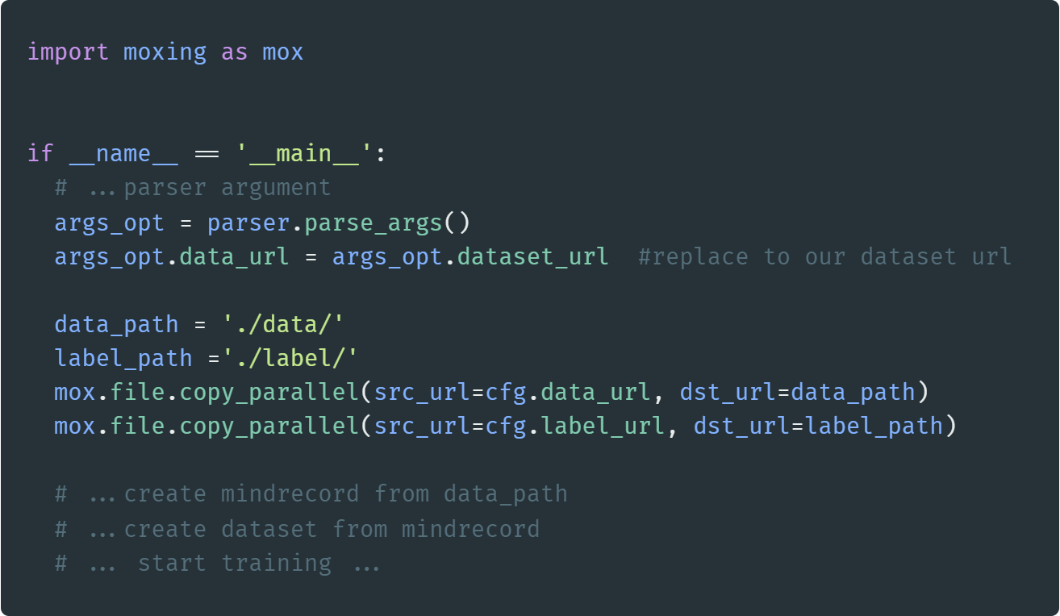
Connect ModelArts & OBS – MoXing Framwork
OBS
ModelArts
Source Code
Algorithm
In the uploaded source code, you will need MoXing to tell ModelArts how to interact with OBS
When training job starts, the algorithm will start execute the source code contain mox.file funciton
https://support.huaweicloud.com/intl/en-us/moxing-devg-modelarts/modelarts_11_0001.html

Slide 21
Post-Training
/04
Learn about the status and logs
Manage Training Jobs version

Slide 22
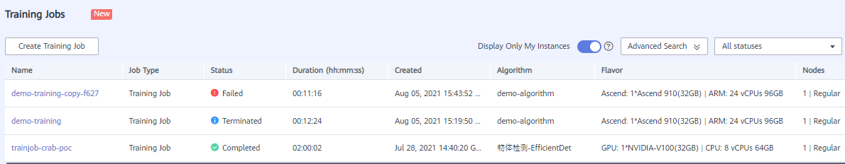
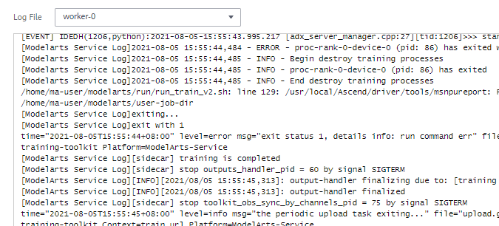
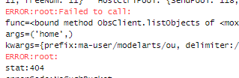
Training Jobs Status & Logs
Training Status
Algorithm Usage
Click →
check Detail and Logs

Slide 23
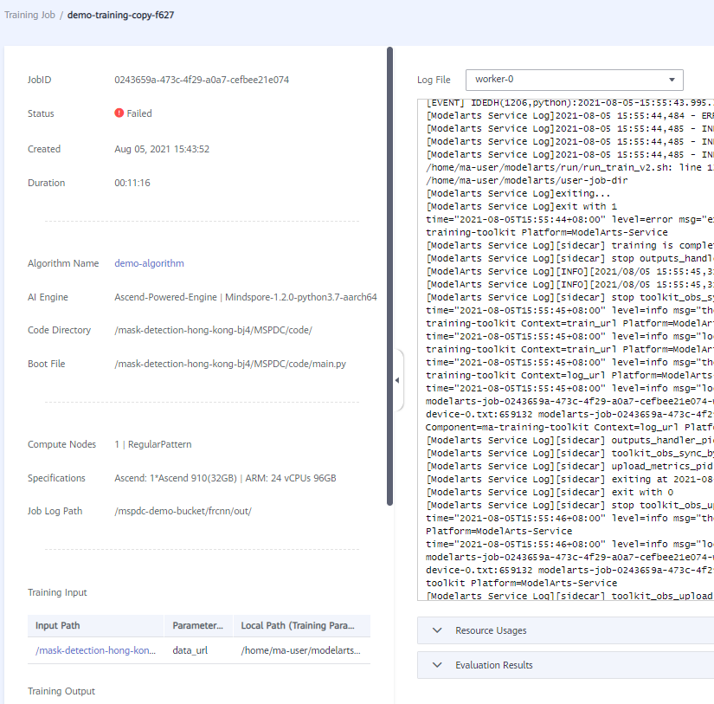
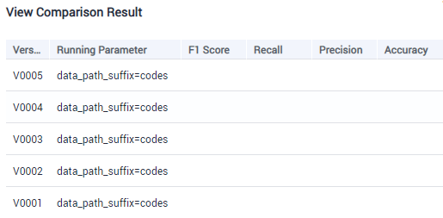
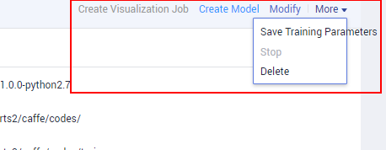
Manage Training Jobs version
Viewing Training Job Versions
Comparing Versions of a Training Job
Training Management > Training Jobs
Version Manager > View Comparison Result
Shortcut Options
Training Management > Training Jobs

Slide 24
Model Evaluation Stage
Detail about the Testing and Evaluation procedure on your model!

Slide 25
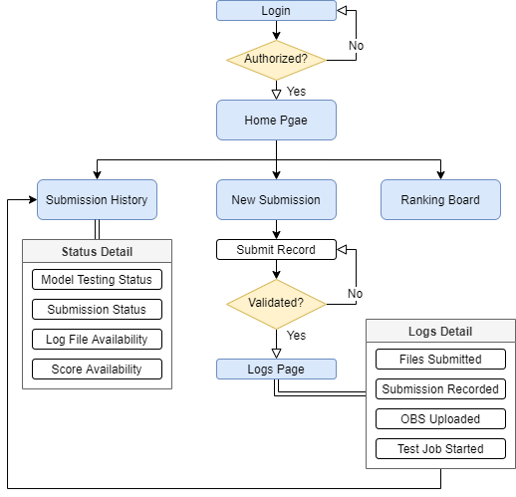
Testing Flow Overview
Main Procedures
1
Login and Authentication
2
Create Testing Jobs on Huawei Cloud ModelArts
3
View Submission Records
4
Realtime Ranking Billboard
5
Logs and evaluation picture for optimizing model

Slide 26
Login & Authentication
/01
Secure your work and submission carefully

Slide 27

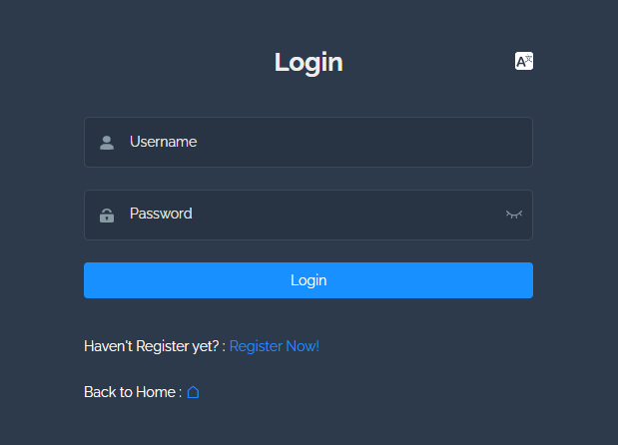

Login & Verification
01. Register & Verified
Every registered team leader will receive an email to confirm
After thorough validation, an email with new password will send back to you
02. API Authentication
Every Step will validate your ID and prevent any suspicious API
03.Change Password
We will give you the password at first
Change password to any kind you like

Slide 28
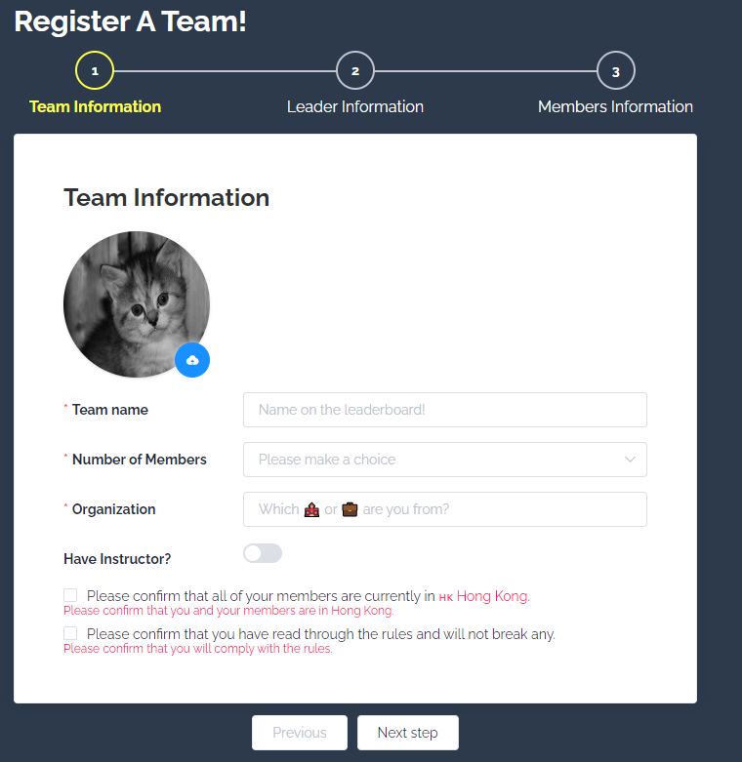
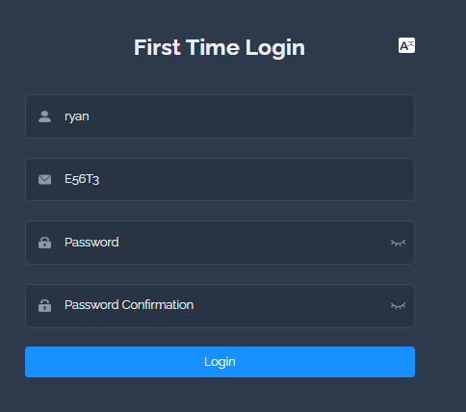
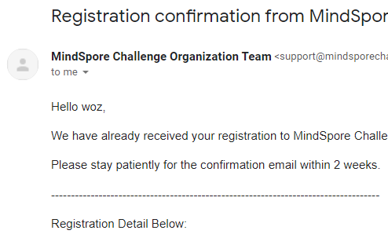
Registration Flow
Within a week, an email will send to
the verified account with a passcode
And user can create your own password then
Go to your email account and
check the registration notification email
Register in 3 steps

Slide 29
Create a New Submission
/02
Create a new submission of code + .ckpt file for score-testing on models

Slide 30
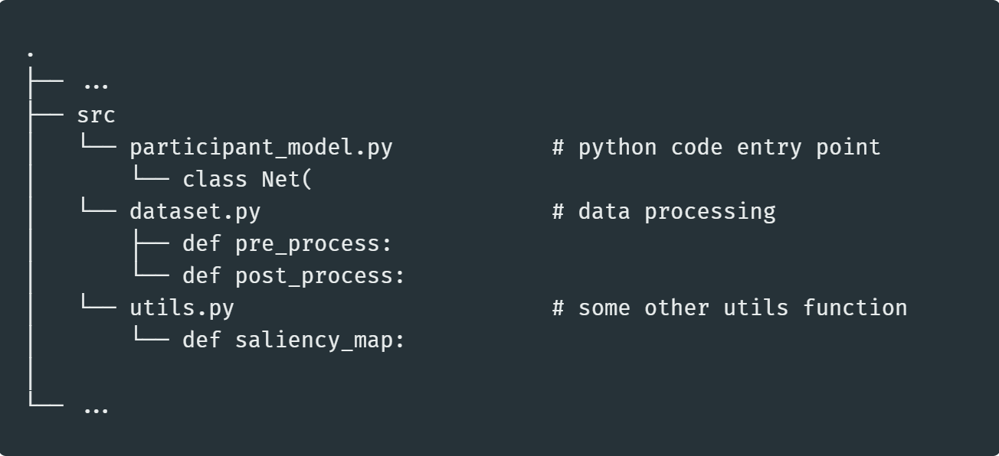
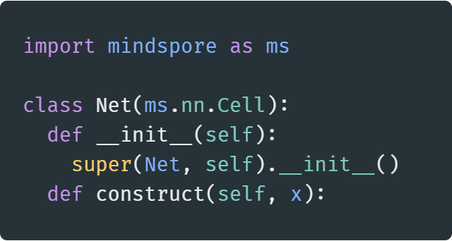
Python Code Submission Structure
To automate the Testing Procedure and Protect the Privacy, please follow the code structure of the template to return the correct score
Possible File Structure
Name | Rules | Description
Submission File Type | .zip folder or .py file | Code for testing model
Entry Point | participant_model.py | Describe the model structure & optional functions
Model Class Name | class Net( mindspore.nn.Cell ) | Class extends mindspore.nn.Cell which is the standard way to instantiate a network in MindSpore
*Pre-Process Function | def pre_process ( image_id, image ) | Preprocess the dataset, so that the network can receive the correct data format
*Post-Process Function | def post_process( image_id, prediction ) | Parse the output from the model, with the No. bounding boxes as first dimension and bounding boxes details as the second dimension
*Explainable Function | def saliency_map( net, image_id, image, predictions ) | Output a saliency map from the model with the image. Utilize the mindspore.explainer toolkit.
Model Class Definition
* = optional function
Please refer to the Rule Book for detail guideline

Slide 31
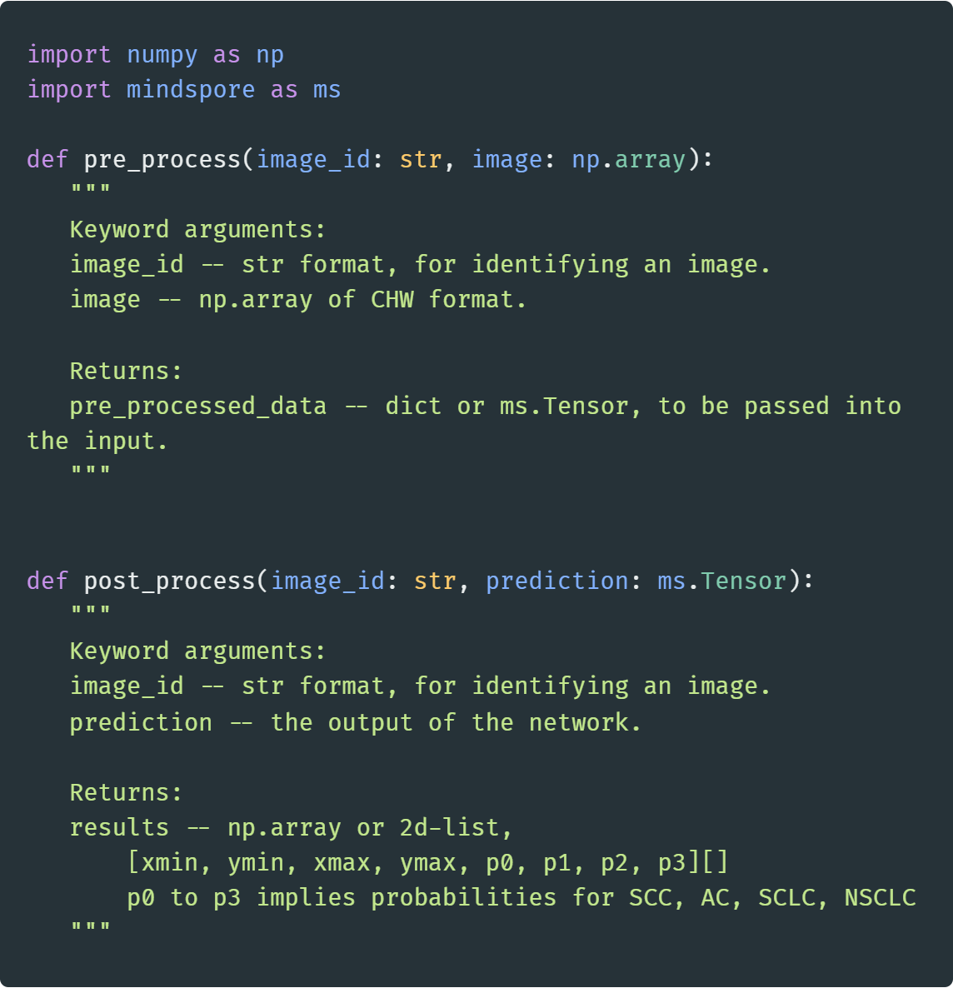
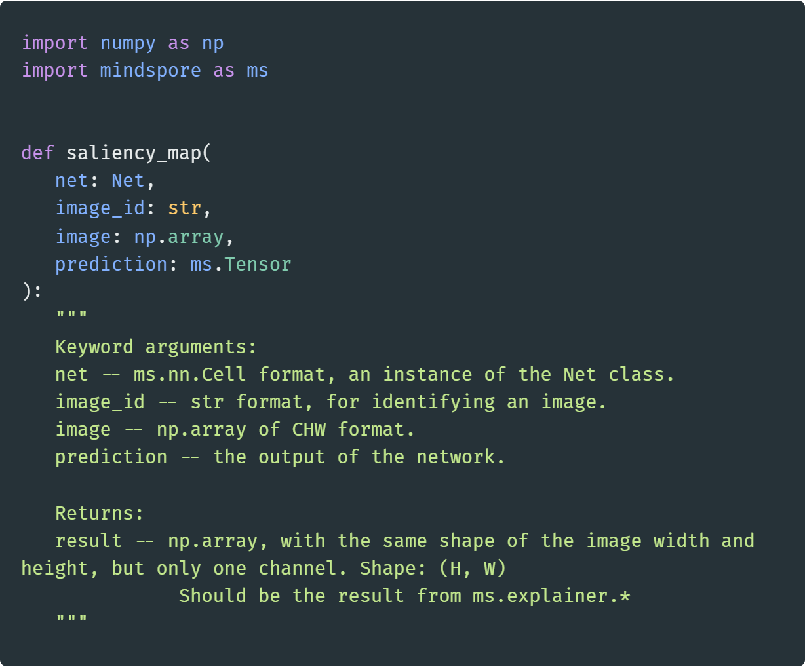
Python Code Submission Structure
To automate the Testing Procedure and Protect the Privacy, please follow the code structure of the template to return the correct score
Data Processing Template Code
Explainable AI Template Code

Slide 32
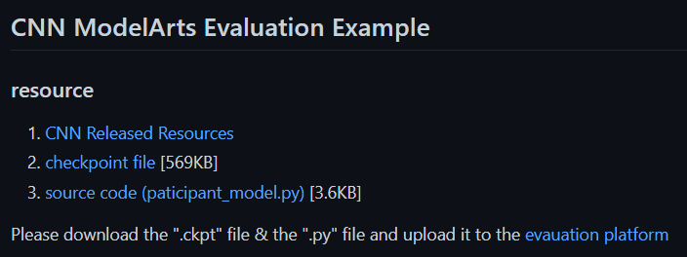
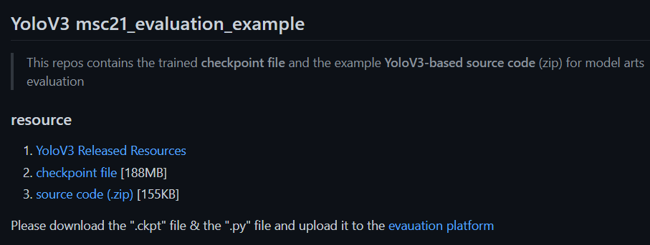
Example Code
https://github.com/MindSporeChallenge21/msc21_evaluation_example
Sliding Window Example Code
YoloV3 Example Code

Slide 33
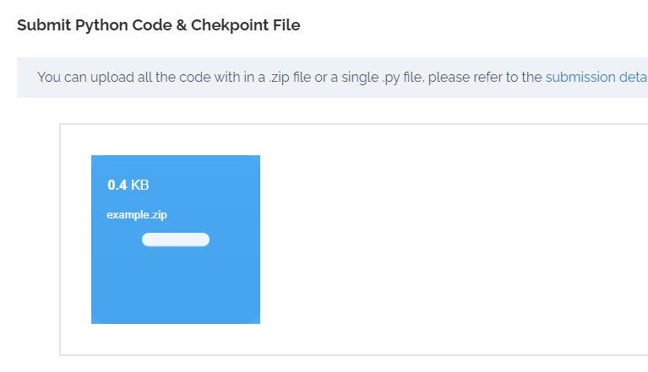
Submit Source Code
https://mindsporechallenge.com/submission/index
Multiple files in a zip file or a .py file are both supported
https://mindsporechallenge.com/submission/
S1
Source Code
S2
Checkpoint File
S3
Double-Check
Submission Detail
Zip file with participant_model.py inside
A single participant_model.py
S4
Submission Logs

Slide 34
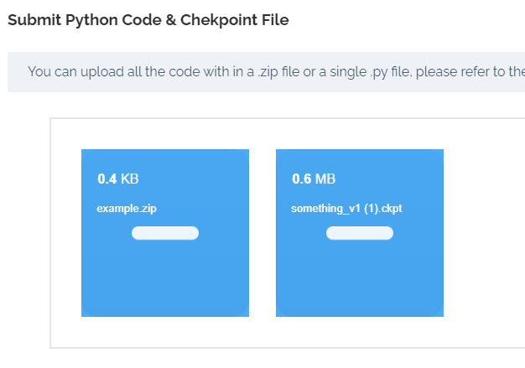
Upload MindSpore Checkpoint File (weights)
Only MindSpore is supported
S1
Python Code
S2
Checkpoint File
S3
Double-Check
Submission Detail
S4
Submission Logs

Slide 35
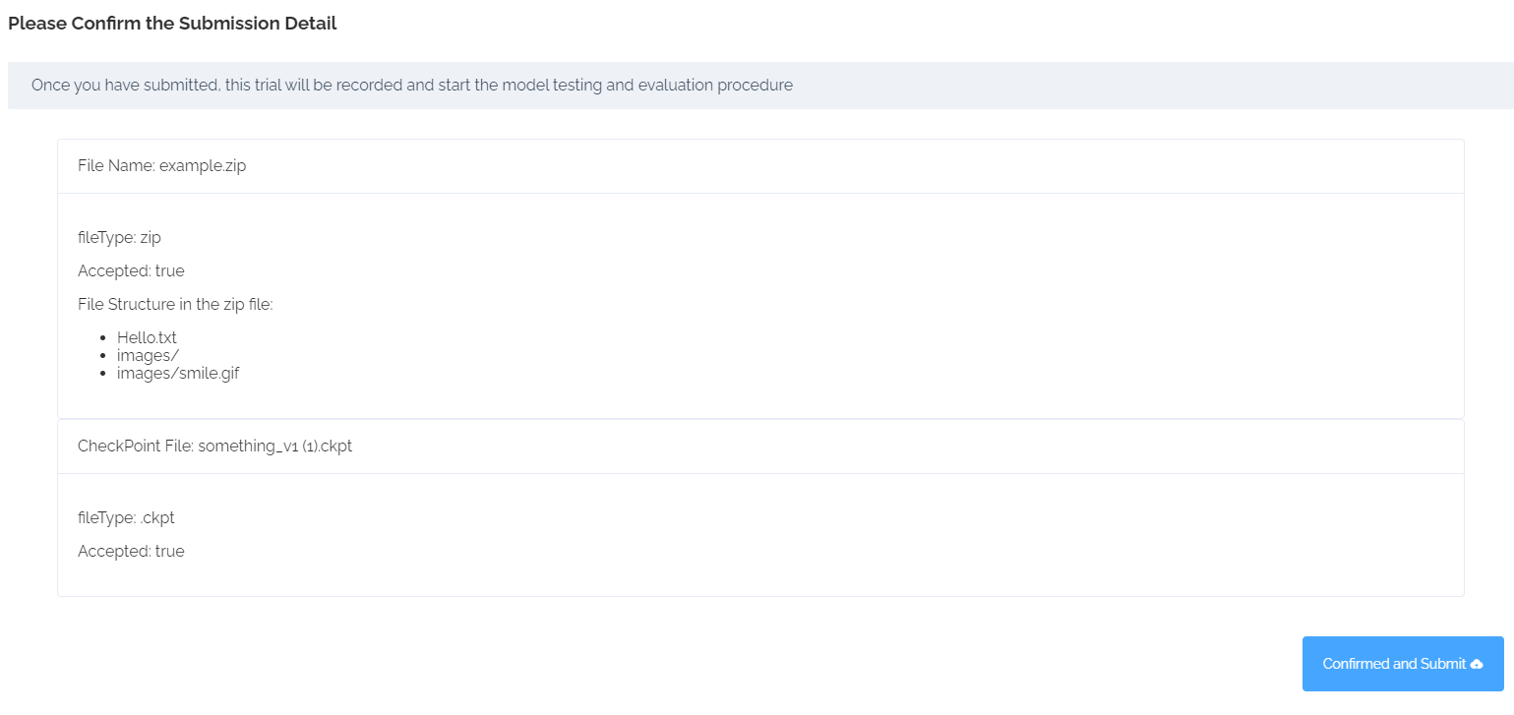
Double Check on the Submission Detail
This will show the file name you are going to submit
S1
Python Code
S2
Checkpoint File
S3
Double-Check
Submission Detail
S4
Submission Logs

Slide 36
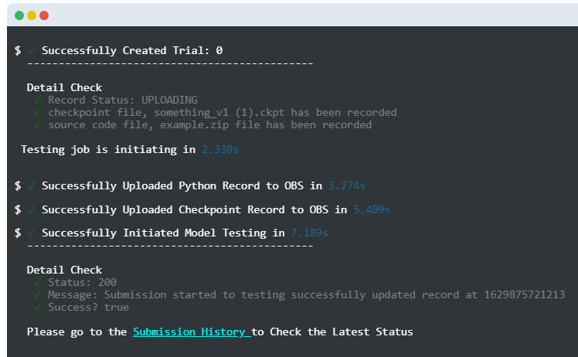
Inspect the Submission Status
Click on the “GO TO SUBMISSION” to check the Testing Status
S1
Python Code
S2
Checkpoint File
S3
Double-Check
Submission Detail
S4
Submission Logs

Slide 37
Inspect on Submission History
/03
All the submissions will go to the Submission History Page for your record

Slide 38
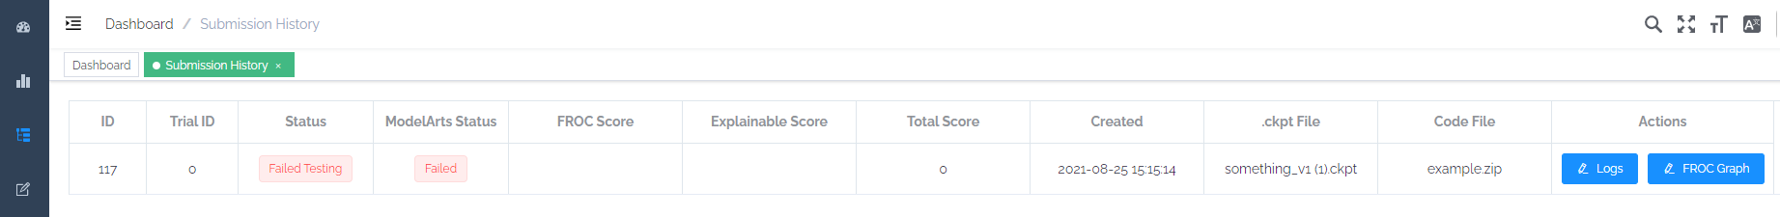
Overview of Submission History
Submission Status on the Server Side
Check Your Score!
FROC/ XAI/ Total
The Status of Model Testing Procedure on ModelArts
Check the Model Testing Logs for debugging
Check the Evaluation Score & FROC Graph

Slide 39
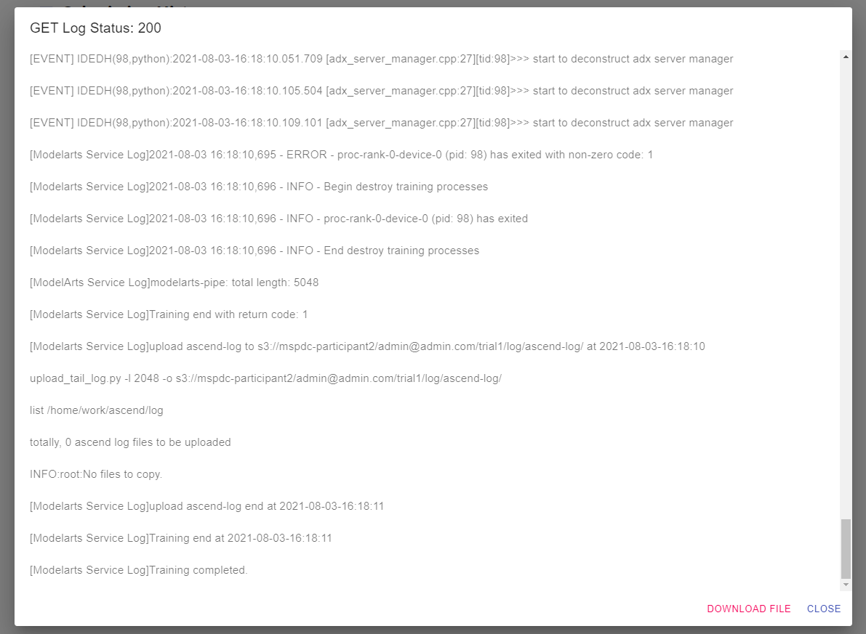
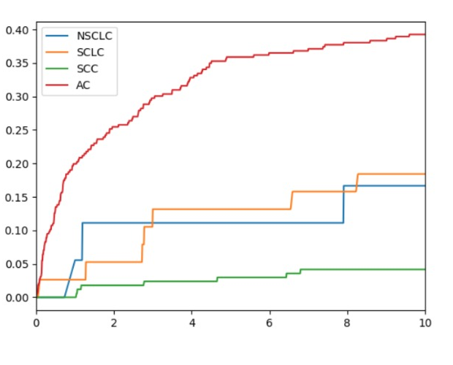
Status Elaboration
Log
File
ID | Status Name | Meaning
0 | JOBSTAT_UNKNOWN | ?
1 | JOBSTAT_INIT | 初始化
2 | JOBSTAT_IMAGE_CREATING | 创建镜像
3 | JOBSTAT_IMAGE_FAILED | 创建镜像失败
4 | JOBSTAT_SUBMIT_TRYING | 提交作业
5 | JOBSTAT_SUBMIT_FAILED | 提交作业失败
6 | JOBSTAT_DELETE_FAILED | 删除作业失败
7 | JOBSTAT_WAITING | 等待
8 | JOBSTAT_RUNNING | 运行中
9 | JOBSTAT_KILLING | 杀死中
10 | JOBSTAT_COMPLETED | 完成
11 | JOBSTAT_FAILED | 失败
12 | JOBSTAT_KILLED | 杀死
13 | JOBSTAT_CANCELED | 取消
14 | JOBSTAT_LOST | 丢失
15 | JOBSTAT_SCALING | 自动伸缩
16 | JOBSTAT_SUBMIT_MODEL_FAILED | 提交模型失败
17 | JOBSTAT_DEPLOY_SERVICE_FAILED | 部署服务失败
18 | JOBSTAT_CHECK_INIT | 检查初始化
19 | JOBSTAT_CHECK_RUNNING | 检查运行中
20 | JOBSTAT_CHECK_RUNNING_COMPLETED | 检查运行中完成
21 | JOBSTAT_CHECK_FAILED | 检查失败
Model
Status
Submission
Status
Status Name
UPLOADING
TESTING
SCORING
LOGGING
COMPLETED
FAILED_UPLOAD
FAILED_TESTING
FAILED_SCORING
FAILED_LOGGING
FAILED
FROC
Score

Slide 40
Check Your Ranking Board!
/04
The highest score’s submission from each team will be display on the Ranking Board

Slide 41

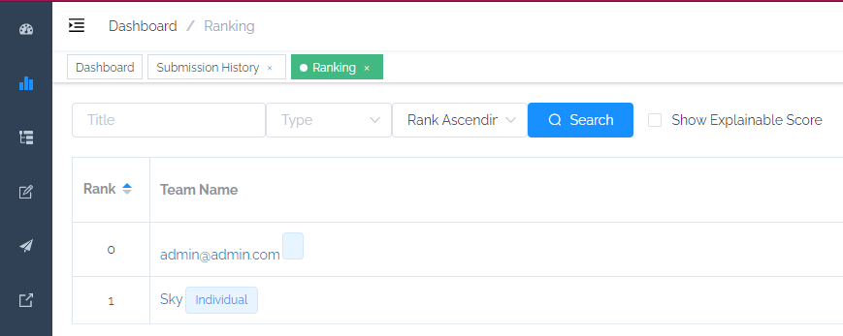
Ranking Board Overview
Ranking Page Detail
Team Name | Total Score | Submission Count
… | … | …
How to Score High?
Submit Earlier!
Higher FROC!
(Check out Rule book for more scoring detail)

Slide 42
Restriction
The evaluation dataset is private and protected, and anyone with unauthorized access to it will be disqualified from the contest.
Plagiarism and Copy code from others will result in a forced exit and risk of intellectual property violations.
Those who vandalize the rating system, and the rating records will be severely punished and disqualified from the competition.
All illegal APIs to the scoring system will be recorded and the team will be disqualified and banned from participating again.

Slide 43





Thanks Join Discord & Checkout GitHub Repos
Discord
GitHub Repos
Official Website
RULE BOOK & GUIDELINES

